Slide 1
Build Microsoft Teams customization using SharePoint Framework
Configuration

Slide 2

Overview
Custom Microsoft Teams Tab Configuration Options
Configure Once at Install
Edit Configuration in the Future

Slide 3
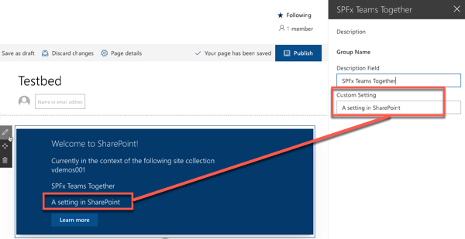
Custom Microsoft Teams Tab Configuration Options
SharePoint Framework web parts have public properties
Public properties can be made editable via the property pane
SharePoint page must be in edit mode to edit properties
User must have edit rights to the page to access the property pane

Slide 4
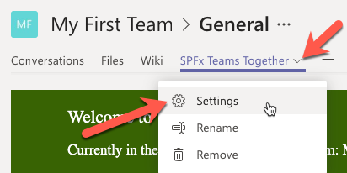
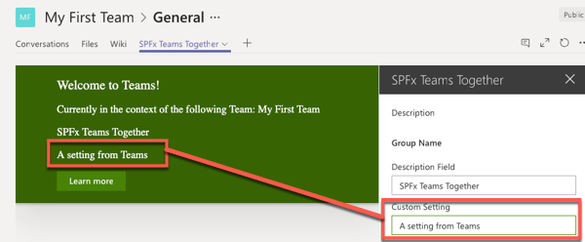
Property Pane Exposed in Microsoft Teams
Web Part property pane displayed when SPFx web part installed as a tab in a Microsoft Teams team
Accessible via the tab context menu Settings option

Slide 5
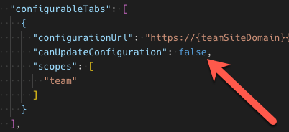
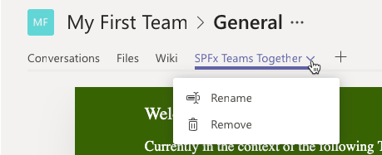
Configure Settings – Edit Only on Install
Developers optionally set property in Microsoft Teams app manifest to only allow SPFx web part properties to be set when tabs installed

Slide 6
Demo Configuring SPFx Web Parts as Microsoft Teams tabs

Slide 7

Summary
Custom Microsoft Teams Tab Configuration Options
Configure Once at Install
Edit Configuration in the Future

Slide 8
Reading further
SharePoint Framework
https://docs.microsoft.com/sharepoint/dev/spfx/sharepoint-framework-overview
Building Microsoft Teams Tabs using SharePoint Framework
https://docs.microsoft.com/sharepoint/dev/spfx/integrate-with-teams-introduction

Slide 9
Thank you.

